Slide 1
Week-05 CLIENT-SIDE PROGRAMMING AND TECHNIQUES- JavaScript
Course Instructors:
Haris Ahmed
DEPARTMENT OF SOFTWARE ENGINEERING
SIR SYED UNIVERSITY OF ENGINEERING & TECHNOLOGY

Slide 2
INTRODUCTION
It includes the set of languages that are used to describe the methods in which the Web pages should be created (like HTML,DHTML, XML, XHTML, CSS, etc.) with some techniques for dynamic content generation in the browser (like Chrome, IE, Mozilla, FireFox,etc.) that runs on the client-side.
We also add scripting (embedded) in between these languages. It is the combination of Web languages, Web browsers and Web scripting languages on the client-side.
So, we can say that:
Client-side programming = Web languages + Web browsers + Scripting languages
Or
(HTML, XML, CSS) + (Chrome, IE, Mozilla, FireFox) + (VBScript, JavaScript) = Client-side programming

Slide 3
JavaScript
JavaScript is a type of client-type scripting language.
JavaScript has three parts, which are as follows:
1. Core: It includes operators, expressions, statements and subprograms.
2. Client-side: It is a group of objects using which a user can have control over the browser. Even user–browser interaction is possible.
3. Server-side: It is a collection of objects using which one can access the database on the server.

Slide 4
JavaScript is not Java
Completely different types of languages that just happen to be similarly named
JavaScript - programs are interpreted in the browser
Java - programs are compiled and can be run as stand alone applications

Slide 5
Including JavaScript in HTML
Two ways to add JavaScript to Web pages
Use the <script>…</script> tag
Include the script in an external file
Note that we can embed the JavaScript directly or indirectly in the HTML document. Hence, we must write the tag as follows:
<script> ….. </script>
But, if we want to embed the JavaScript indirectly, i.e., if the script is written in some another file and we want to embed that script in the XHTML document, then we must write the script tag as follows:
<script src=“MyPage.js”> ….. </script>
Here, the JavaScript that is to be embedded is in the file MyPage.js

Slide 6
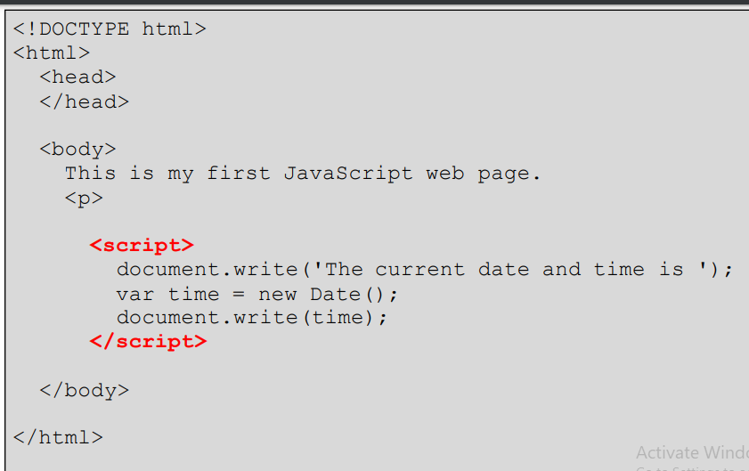
Code Recap-i
Write a JS code to display current date and time on webpage

Slide 7
Declaring a Variable
The basic syntax for declaring any JavaScript variable is
var variableName = …
var age = 22;
var name = ‘Jane Doe’;
var isMale = false;
You can also use console.log(var)to print a variable’s value in the browser’s JavaScript console
<script>
var age = 12;
console.log(age);
</script>

Slide 8
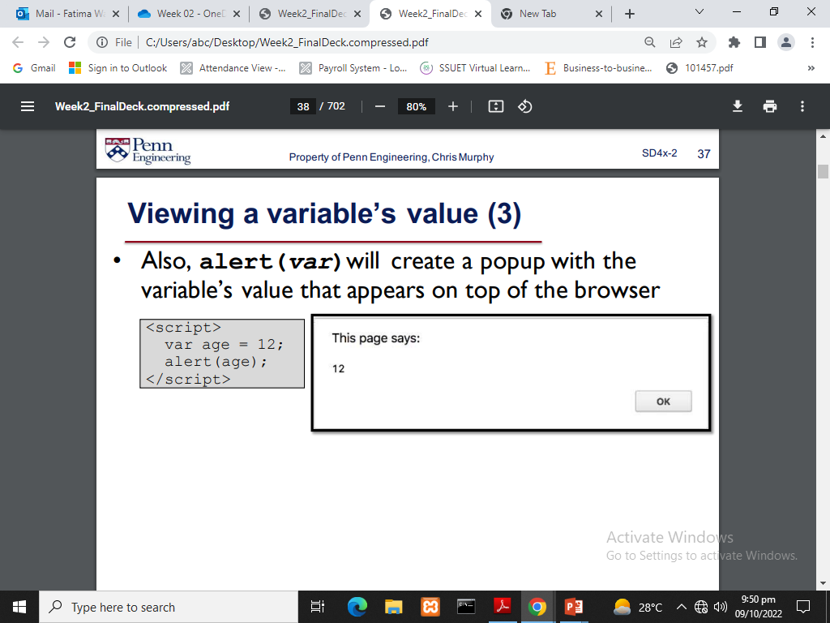
Viewing a variable’s value
Also, alert(var)will create a popup with the variable’s value that appears on top of the browser

Slide 9
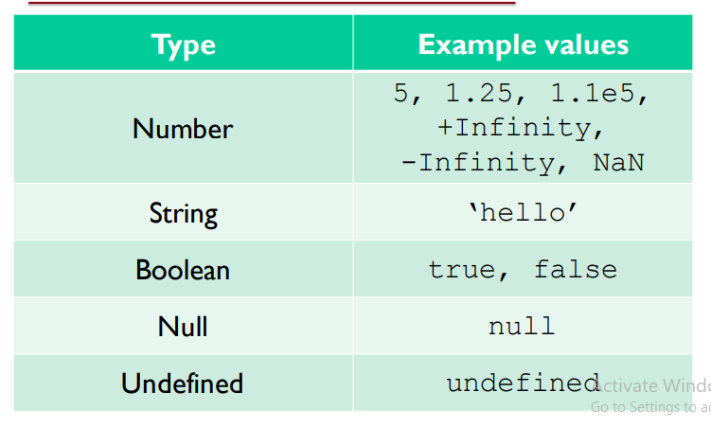
Primitive Types

Slide 10
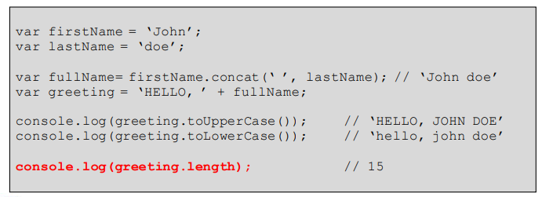
String Functions

Slide 11
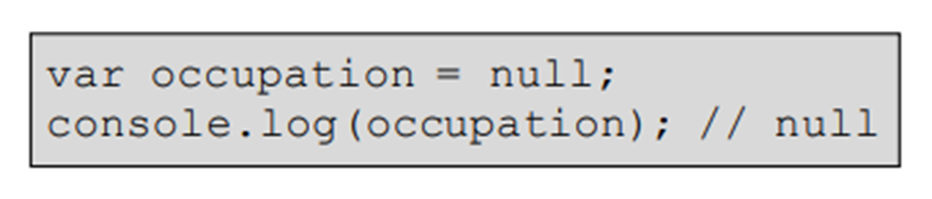
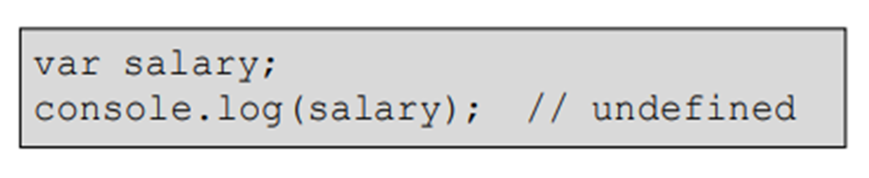
Null and Undefined
Null is a value that can be assigned to variables to represent “no value”.
Undefined means that a variable was declared but no value has been assigned.

Slide 12
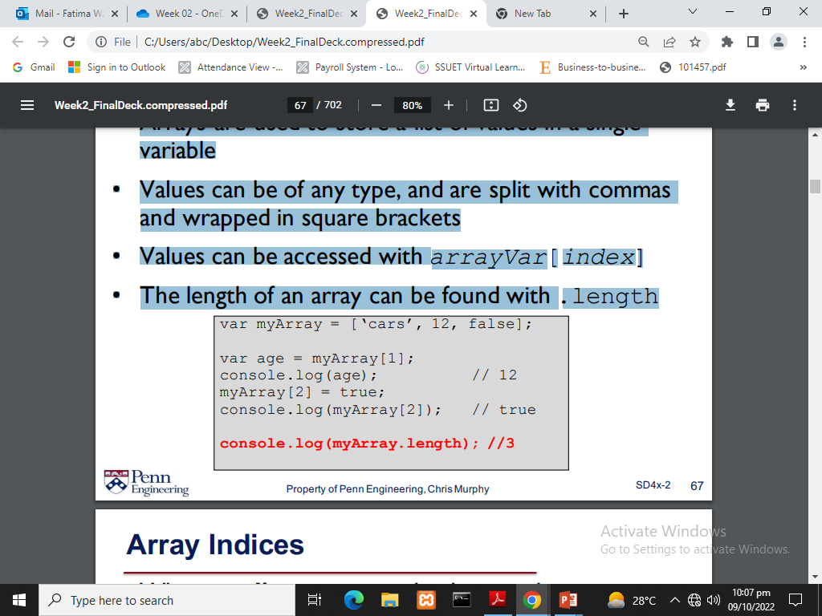
Arrays
Arrays are used to store a list of values in a single variable
Values can be of any type, and are split with commas and wrapped in square brackets
Values can be accessed with arrayVar[index]
Linear way .
The length of an array can be found with .length
.for length [age.length]
Type of array is object

Slide 13
Array Indices
Array index is a numerical position that identifies a specific element inside an array. Indices typically start at 0 (zero-based indexing) in most programming languages (C, Java, Python, JavaScript, etc.).
Strings cannot be changed after creation (immutable), but arrays can be modified after creation (mutable).
arr = [10, 20, 30, 40, 50]
# index: 0 1 2 3 4
arr=[1,2,6,4];
arr[4]; find array index 4
arr[2]=66; replace index with 66 value

Slide 14
Loop in ARRAY
arr=["ahmed",“ahmed"];”array length 2”
console.log[arr]
arr[4];
arr[2]=66;
for (let i = 0; i < arr.length; i++)
console.log(arr[i]);

Slide 15
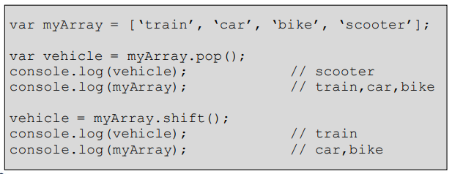
Removing from an Array
Elements can be removed from arrays using pop() and shift()
pop() will remove and return an element from the end of the array
shift() will remove and return an element from the beginning

Slide 16
Adding to an Array
adding
arr=["ahmed","aris"];
arr.push('hh’); “for adding”
For delete
arr.pop();
Let deletedarr= arr.pop();

Slide 17
slice() and splice()
Does NOT change the original array, creates a new array instead
let arr = [1,2,3,4];
let newArr = arr.slice(1,3); //2 and 3 print
DOES change the original array (removes or adds elements)
let arr = [1,2,3,4];
arr.splice(2,0,500,);//( [1, 2, 500, 3, 4]

Slide 18
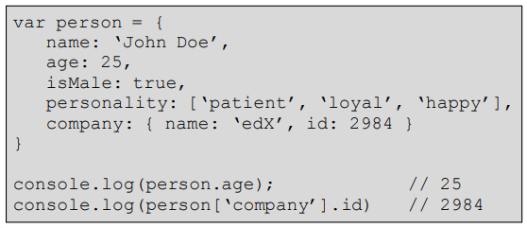
Objects
JavaScript objects are used to store key-value pairs
Values can be of any type, including arrays and objects!
Values can be accessed by myObject.property or myObject[‘property’]

Slide 19
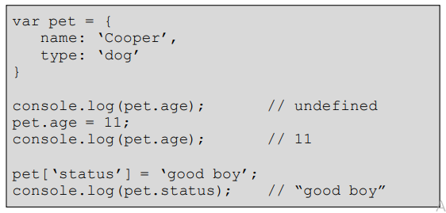
Modifying Objects
Key-value pairs can be added to objects, even after their initial declaration.

Slide 20
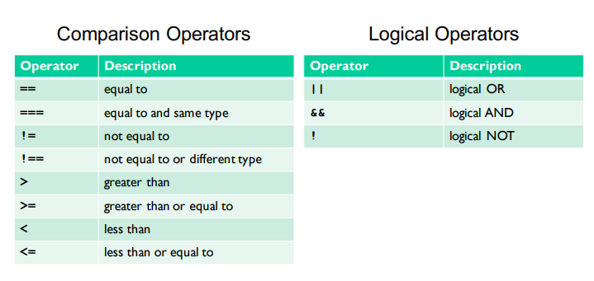
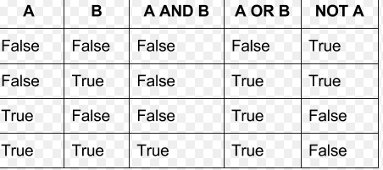
Comparison and Logical Operators

Slide 21
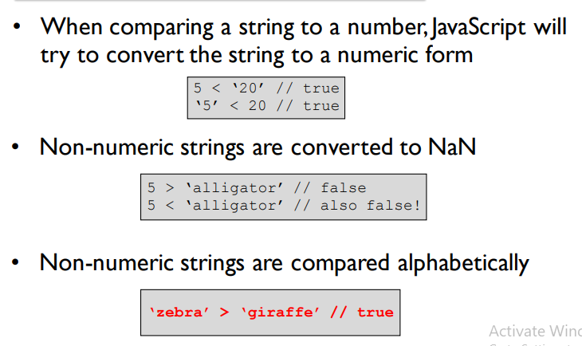
Comparing Numbers and Strings

Slide 22
Functions
In JavaScript, a function is a block of code that performs a specific task and can be reused whenever needed.
function sayHello() {
console.log("Hello");
}
sayHello();
function sum(a, b) {
return a + b;
}
console.log(sum(5, 7));

Slide 23
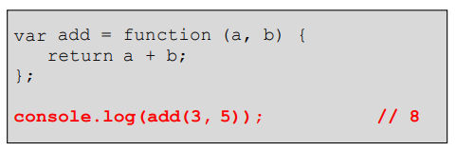
Functions as Objects
JavaScript functions are objects
Therefore, functions can take advantage of the benefits of an object, such as having properties
Since JavaScript functions are objects, we can have variables refer to them

Slide 24
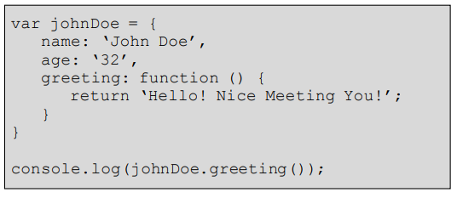
Functions in Objects
JavaScript functions can also be declared and used in objects.

Slide 25
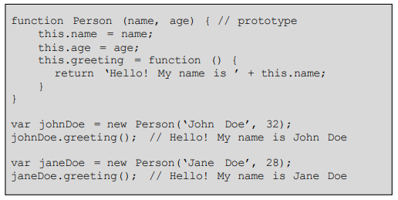
Creating a Object Prototype
Prototypes are created like any other JavaScript function or object
The this keyword refers to the current object
The new keyword can be used to create new objects from the same prototype

Slide 26
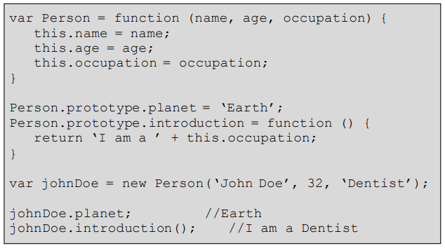
Prototype Properties
Properties and methods can be added to prototypes by adding them to the prototype property.

Slide 27
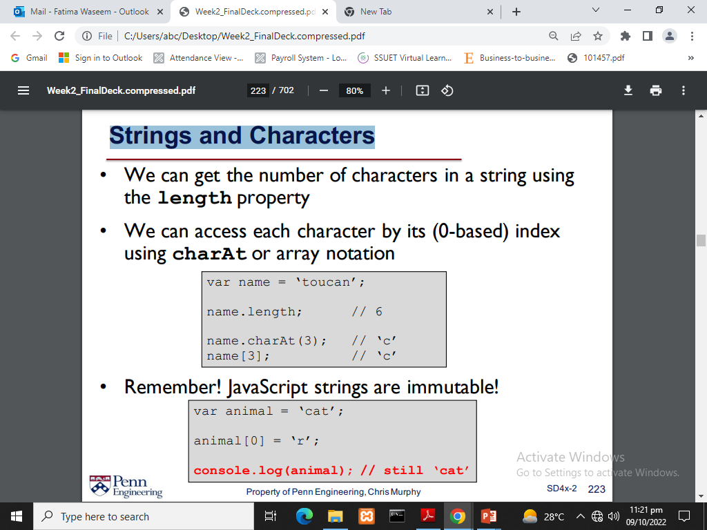
Strings and Characters

Slide 28
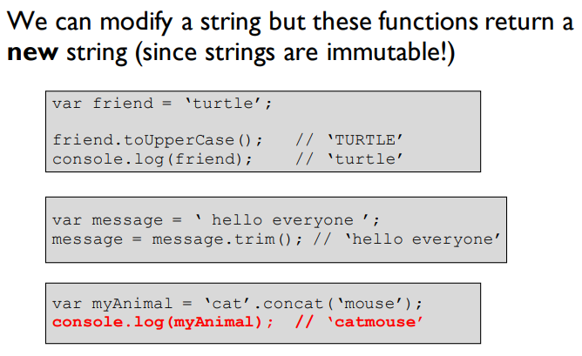
Modifying Strings

Slide 29
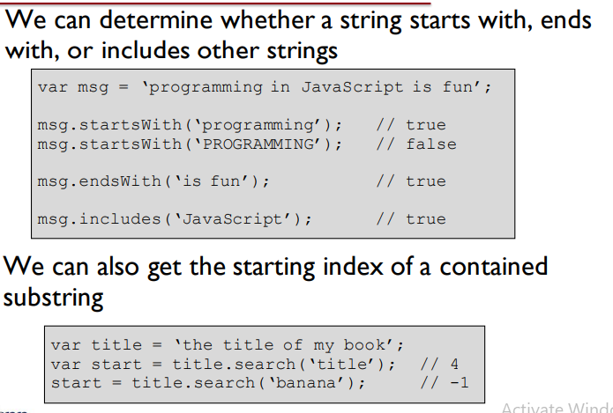
Searching Strings

Slide 30
Regular Expressions
A regular expression is a pattern of characters
A string matches a regular expression if it adheres to the same pattern
Example: “consists of exactly three digits (0-9)”
‘123’ matches
‘abc’ does not match
‘12’ does not match
‘12345’ does not match

Slide 31
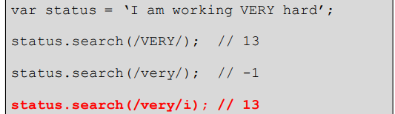
Simple Regular Expression Matching
We can pass a regular expression to the string’s search function to see if it matches the pattern
In general, it is considered a match if any part of the string matches the regular expression
Notes:
Ignore Case
case insensitive

Slide 32
Type casting / coercion in JavaScript
Suppose there is an operand A with type Number. If we want to concatenate it with operand B, which is of String type, then in such a case, the Number operand will also be converted to String type.
JavaScript supports such automatic conversion. This technique of implicit conversion is called coercion.
Types of coercions:

Slide 33
1. Implicit conversions:
It is illustrated with the following examples:
(a) “Dr. Rajiv Chopra” + 40 will give “Dr. Rajiv Chopra 40”
(b) If we write 2 * “10”, then the second string will also be converted to number and the evaluation will result in 20.
(c) If we write 7 * “Rajiv”, then the second operand (a string) will not be converted to numeric value and we will get the result NaN.
For Boolean data, the following points should be remembered:
(a) The number 0 is treated as false and any other number is treated as true.
(b) An empty string is considered to be false and all other strings are taken as true.
(c) The special value NaN is taken as false.
(d) The undefined value is taken as false.
Let us use this in a simple program now.

Slide 34
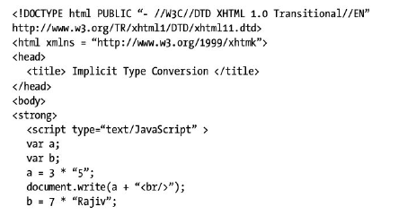
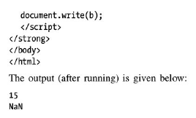

Slide 35
2. Explicit conversion:
One can forcefully perform the type conversion in JavaScript. The numeric value can be converted to a string type using the toString method.
For example,
var numb = 7;
var str;
str = numb.toString( );
This would result in “7” in str.
In JavaScript, the explicit conversion can be done as follows:
(a) Boolean(value) will convert value to Booelan type.
(b) Number(value) will convert value to Number type.
(c) String(value) will convert value to String type.
(d) There are two methods that are used to separate out the numeric data from alphanumeric value. These methods are parseInt( ) and parseFloat( ).
For example,

Slide 36
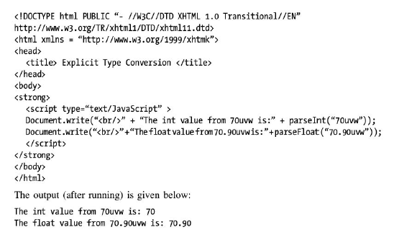
CONTD…

Slide 37
Write a program to display Square of number from 1-5
Number Square
1 → 1
2 → 4
3 → 9
4 → 16
5 →25

Slide 38
How do we use JavaScript and HTML?
Now that we’ve seen JavaScript, how can we use it to access/modify HTML elements?
This is done by using the DOM
The Document Object Model is a structured tree representation of a web page
The HTML of every web page is turned into a DOM representation by the browser

Slide 39
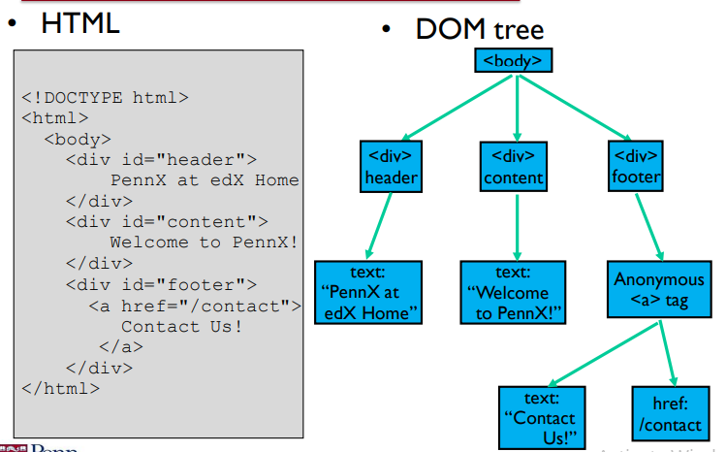
What does the DOM look like?

Slide 40
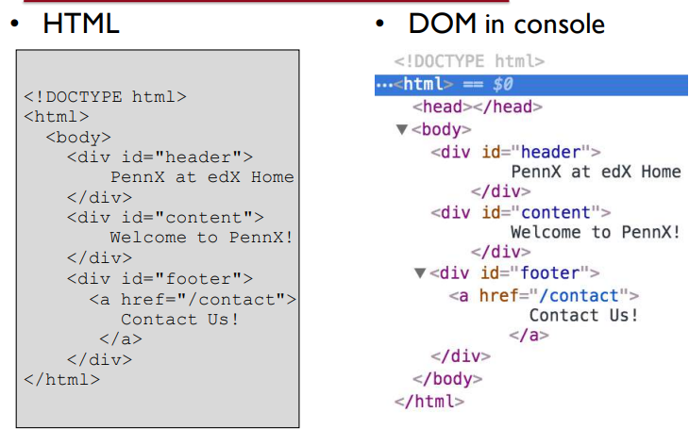
What does the DOM look like?

Slide 41
Why the DOM?
Remember, HTML specifies the structure of the content on the Web page
The DOM provides a way for us to programmatically access that structure in JavaScript
console.log(document); “for html code ”
console.dir(document) “for function and method”
id → getElementById() class → getElementsByClassName() tag → getElementsByTagName() name → getElementsByName()

Slide 42
DOM Example
<h1 id="title">Hello</h1>
<button onclick="changeText()">Click</button>
IN DOM
function changeText() {
document.getElementById("title").innerText = "Welcome";
}

Slide 43
DOM Example
For Tag
<h2>Welcome</h2>
document.getElementsByTagName("h2");
By name
<input name="username">
document.getElementsByName("username");

Slide 44
DOM Example
For css
<h1 id="box">Box</h1>
<button onclick="changeColor()">Color Change</button>
In dom
function changeColor() {
document.getElementById("box").style.color = "red";
}
<div id="card">My Box</div>
<button onclick="bgChange()">Change BG</button>
function bgChange() {
document.getElementById("card").style.backgroundColor = "yellow";
}

Slide 45
DOM Example
For add class
<h1 id="title" class="old">Hello</h1>
<button onclick="addClass()">Add Class</button>
Dom
function addClass() {
document.getElementById("title").classList.add("new");
}
document.getElementById("title").classList.remove("new"); “for remove”

Slide 46
jQuery
Simplifies JavaScript usage on webapps
More intuitive way of DOM manipulation
Great cross-browser support (Except IE6)
Additional Utilities
Effects and Animations
Customizable plugins

Slide 47
Selecting DOM Elements
document.getElementById("title");
$("#title");
document.getElementsByClassName("text");
$(".text");

Slide 48
Selecting DOM Elements
For change text
document.getElementById("title").innerText = "Hello";
$("#title").text("Hello");
document.getElementById("title").style.color = "red";
$("#title").css("color", "red");

Slide 49
Selecting DOM Elements
Click event
document.getElementById("btn").addEventListener("click", function(){
alert("Clicked");
});
In jquery
$("#btn").click(function(){
alert("Clicked");
});
For hide element
document.getElementById("box").style.display = "none";
$("#box").hide();

Slide 50
jQuery DOM Manipulation
To manipulate DOM contents, the general format is
$(selector).action(arguments…)
To add an event listener to an element, the general
format is $(selector).event(callback)
$(“#name”).html(“Hello”);
$(“#name”).append(“ World!”);
$(“#name”).addClass(“greeting”);
$(“#name”).hide();
$(“#name”).show();

Slide 51
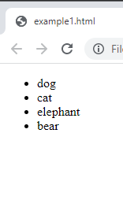
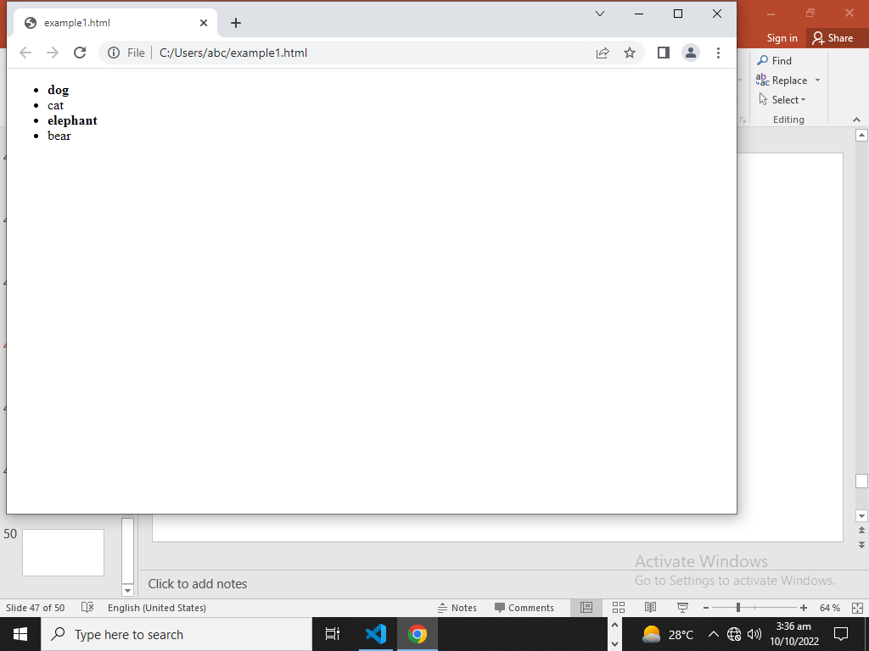
example
<!DOCTYPE html>
<html lang="en">
<head><script src="https://ajax.googleapis.com/ajax/libs/jquery/3.6.0/jquery.min.js"></script>
</head> <body>
<ul>
<li>dog</li>
<li>cat</li>
<li>elephant</li>
<li>bear</li>
</ul>
<script>
$('li').click(function() {
$(this).css('font-weight', 'bold');
});
</script> </body> </html>

Slide 52
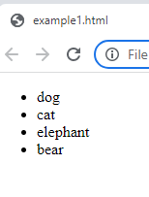
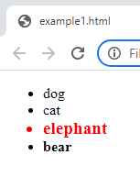
Write a program which does following:
When mouse hovers around any list item, color changes to red and font size increases to 120%.
When it leaves, it returns to standard black color and normal size.

Slide 53
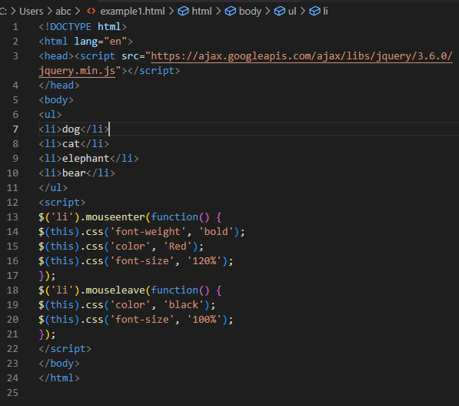

Slide 54
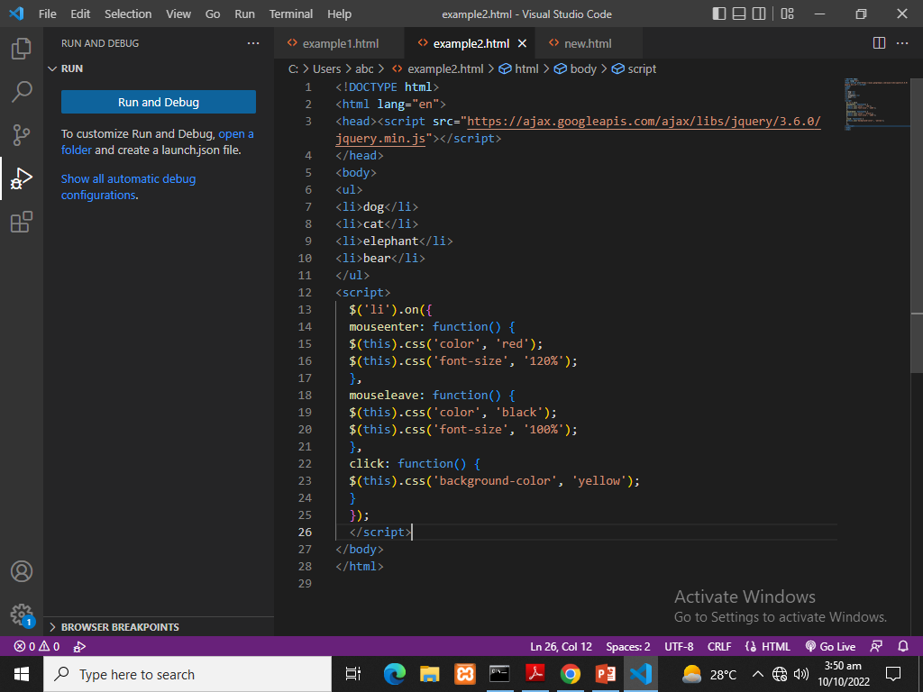
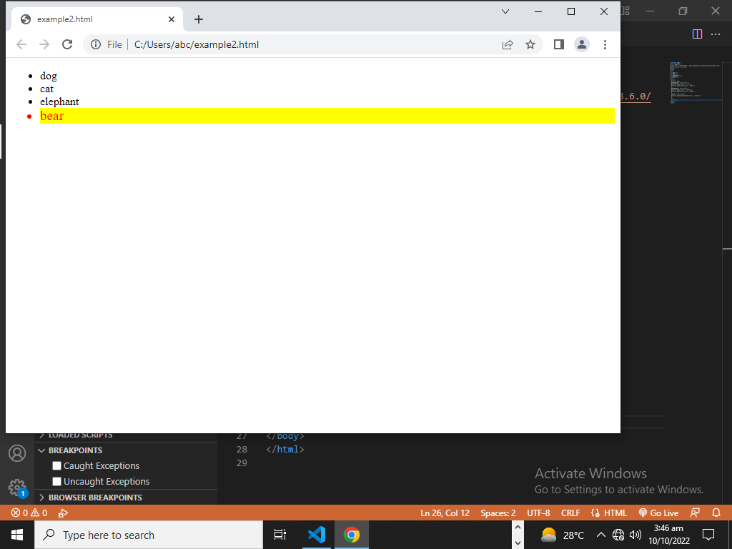
Now add background color to yellow on clicking any list item:

Slide 55
Advanced Selectors
$(someNodes).find(selector) will search someNodes’ children for selector.
$ selectors can be chained
$("div.book") selects the div with class=“book”
$("div, .book") selects all divs and all elements with class=”book”
: can be used to specify element properties
$("p:hidden") selects all <p> elements that are visually hidden
These selectors are all CSS selectors!
All other CSS selectors also work in $

Slide 56
SUMMARY
JavaScript: a general-purpose, easy-to-use programming language
DOM: representation of structure of HTML page, which can be manipulated using JavaScript
jQuery: library that simplifies accessing/using the DOM

Slide 57
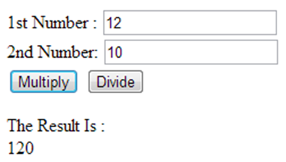
Class Assignment
Write a JavaScript program to calculate multiplication and division of two numbers (input from user).

